Slide 1
FINANCIAL MODELS IMPLEMENTED USING QUANTUM COMPUTING
21BCE5103 - Anjaneya Divekar
21BCE6145 - Mohini Avinash Patil
21BCE5115 - Armaan Saini
Project guide: Dr. Pradeep K. V.

Slide 2
INTRODUCTION
Statement of Problem/Challenges (Research Question)
Traditional stock price prediction models face significant limitations due to their inability to effectively integrate and process multiple heterogeneous data sources such as historical stock prices, company financial statements (balance sheets), and real-time news sentiment. This leads to incomplete market analysis and reduced prediction accuracy. Additionally, classical computing methods struggle with handling the computational complexity required to process these diverse and voluminous datasets efficiently. The problem is to develop a more accurate and efficient stock price prediction model that overcomes these limitations.

Slide 3
INTRODUCTION
Challenges (Research Question)
How can a hybrid quantum-classical model—specifically integrating quantum computing with Long Short-Term Memory (LSTM) networks—be utilized to effectively process and integrate historical stock data, balance sheet information, and news sentiment analysis to improve the accuracy and computational efficiency of stock price predictions?

Slide 4


PROBLEM STATEMENT
This study aims to develop a hybrid quantum-LSTM model that combines historical stock data, financial news sentiment, and company balance sheets to improve the accuracy of stock price predictions. Quantum computing will address the limitations of classical methods by enhancing computational efficiency, enabling the model to process diverse and large datasets faster and more effectively. This approach promises to provide a more holistic and accurate understanding of stock market trends, improving investment strategies and market predictions.

Slide 5

RESEARCH OBJECTIVE
1
1.Develop Hybrid Quantum-LSTM Model:Combine quantum computing and LSTM networks to process complex financial data and enhance prediction accuracy.
2. Integrate Heterogeneous Data Sources:
Effectively integrate historical stock prices, company balance sheets, and financial news sentiment for a more comprehensive prediction model.
2
3. Improve Computational Efficiency:
Leverage quantum computing to reduce processing time and resource consumption, enabling faster analysis of large datasets.
3
4
4. Enhance Prediction Accuracy:
Capture complex financial dynamics and improve predictive accuracy over traditional models.
5. Evaluate Model Performance:
Compare the hybrid model's performance with existing models to validate improvements in accuracy and efficiency.
5

Slide 6

METHODOLOGY
• Data Gathering
– Compile news articles, conference call transcripts, historical stock prices, and corporate balance sheets.
– Ensure data consistency and reliability by sourcing from trusted providers.
• Preprocessing
– Clean and normalize the data to handle missing values and outliers.
– Perform sentiment analysis (NLP) on news and transcripts to derive sentiment scores.
• Model Training
– Build and train a traditional LSTM model on historical price data as a baseline.
– Develop and train a quantum-enhanced LSTM model to explore potential performance gains.
• Feature Engineering
– Extract financial metrics (e.g., debt-to-equity, EPS) from balance sheets.
– Conduct both long-term (e.g., trend analysis) and short-term (e.g., moving averages) analysis for richer insights.
• Model Integration
– Combine outputs from the LSTM models, sentiment module, and financial analysis.
– Employ ensemble or weighted methods to integrate diverse signals into a unified pipeline.
• Prediction
– Use the integrated model to forecast future stock values.
– Generate predictions on a regular schedule (daily, weekly) for ongoing analysis.
• Evaluation and Refinement
– Backtest using historical data to assess accuracy (e.g., RMSE, MAE).
– Perform parameter tuning and iterative improvements.
– Continuously update the model with new data to maintain real-world relevance.

Slide 7




PROPOSED SYSTEM INTRODUCTION
The stock market is highly volatile and influenced by multiple factors such as historical trends, news sentiment, and financial reports.
Traditional LSTM models have shown promise in time-series forecasting but have limitations in handling large-scale complex data.
Quantum LSTM (QLSTM) combines quantum computing with deep learning to enhance prediction accuracy and computational efficiency.
The proposed system integrates historical stock prices, news sentiment analysis, and financial balance sheets into a QLSTM model to improve stock price forecasting.

Slide 8
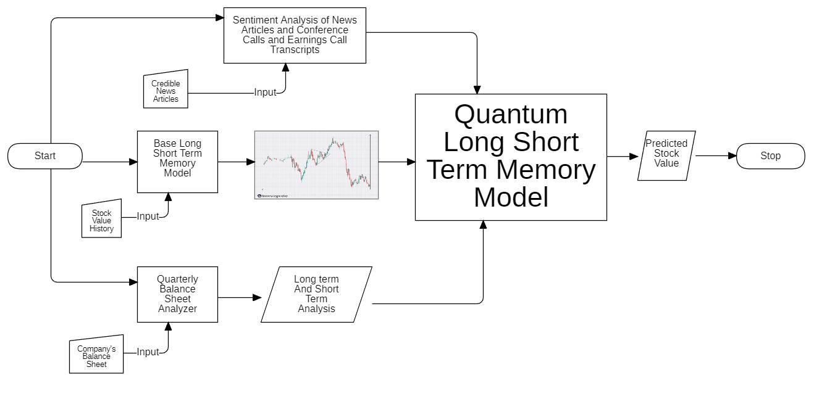
PROPOSED SYSTEM DIAGRAM

Slide 9
LIST OF MODULES
The system consists of the following modules:
Base Long Short-Term Memory (LSTM) Model – Processes stock value history.
Sentiment Analysis – Analyzes financial news and earnings calls for market sentiment.
Quarterly Balance Sheet Analyzer – Evaluates financial statements for stock health.
Long-Term and Short-Term Analysis – Identifies key financial trends.
Quantum Long Short-Term Memory Model (QLSTM) – Enhances predictive accuracy using quantum computing.
Predicted Stock Value – Outputs the final stock price prediction.

Slide 10
MODULES
Base LSTM Model
• Data Flow & Preprocessing:
• Model Architecture & Training:
• Role in System:
– Uses historical stock data (Open, High, Low, Close, Volume).
– Rolling window approach to create sequences for LSTM input.
– Normalization (e.g., MinMaxScaler).
1–2 LSTM layers , dropout to prevent overfitting.
– Optimizer: Adam; Loss: MSE.
– Early stopping based on validation loss.
– Provides baseline predictions using purely historical time-series data.

Slide 11
MODULES
Sentiment Analysis
  • Data Collection & Preprocessing:
  – Financial news articles, social media data, earning call transcripts.
  – Tokenization, removal of stop words, possible lemmatization.
  • Algorithm:
  – Could use LSTM, BERT, or rule-based NLP approaches.
  – Produces sentiment scores (positive/negative/neutral or continuous scale).
  • Integration in System:
  – Sentiment scores combined with historical stock trends to account for market psychology.

Slide 12
MODULES
Quarterly Balance Sheet Analyzer
• Data Input:
– Quarterly/annual financial statements (income statement, balance sheet, cash flow).
• Algorithm/Techniques:
– Ratio Analysis (Debt-Equity, EPS, ROI) or ML-based anomaly detection.
– Automated parsing for PDF/HTML scraping structured CSV for financial metrics.
• Contribution to the System:
– Provides fundamental indicators such as liquidity, profitability, growth potential.
– Helps model real-world financial health beyond market sentiment

Slide 13
MODULES
Long-Term and Short-Term Analysis
• Approach:
– Time-series decomposition for trend, seasonality, and residual noise.
– Moving averages (SMA, EMA) or window-based ML for short-term volatility.
• Implementation Details:
– Parallel pipelines can run to separately analyze multi-day, weekly, or monthly price trends.
• Integration:
– Produces refined signals on immediate (short-term) fluctuations and overarching (long-term) market direction.
– Helps the system differentiate between transient anomalies and established trends

Slide 14
MODULES
Quantum LSTM Model (QLSTM)
Key Concept:
– Utilizes quantum computing constructs (qubits, parameterized quantum circuits) integrated with LSTM principles.
• Implementation Outline:
– Data Encoding: Convert classical inputs (historical, sentiment, fundamentals) to quantum states.
– Quantum Circuit: Parameterized gates act akin to LSTM gating mechanisms.
– Measurement/Output: Collapse quantum state to produce a classical hidden state for final prediction.
• Benefits:
– Potentially higher capacity for complex pattern recognition.
– Faster convergence or improved performance on large-scale data sets

Slide 15
MODULES
Final Predicted Stock Value
Fusion of Modules:
– Aggregates outputs from Base LSTM, Sentiment Analysis, Financial Module, and QLSTM.
– Weighted or concatenated feature-level integration.
• Prediction Layer:
– Dense output layer with a single neuron for price (regression) or multiple neurons if multi-step forecast needed.
• Practical Outcome:
– Continuous predicted stock price reflecting historical trends, market sentiment, fundamental health, and quantum insights.
• Validation & Evaluation:
– Compare predicted prices against actual data for RMSE, MAE, MAPE, or R².
– Conduct ablation studies to measure each module’s contribution.

Slide 16
RESULTS
THE EXPERIMENTAL EVALUATION REVEALED DISTINCT PERFORMANCE CHARACTERISTICS FOR THE TWO MODELS. THE LSTM MODEL RECORDED A TRAINING RMSE OF 49.20 AND A TESTING RMSE OF 60.10, WITH TRAINING AND TESTING ACCURACIES OF 96.36% AND 94.51%, RESPECTIVELY. IN CONTRAST, THE QLSTM MODEL DEMONSTRATED AN EXTREMELY LOW TRAINING RMSE OF 0.0381 AND A TESTING RMSE OF 0.0987, ALONG WITH TRAINING ACCURACY OF 98.84% BUT A TESTING ACCURACY THAT DROPPED TO 81.08%. THE ACCOMPANYING GRAPHS VISUALLY CAPTURE THESE TRENDS, HIGHLIGHTING BOTH THE CONVERGENCE BEHAVIOR DURING TRAINING AND THE GENERALIZATION GAP OBSERVED IN THE QLSTM MODEL.

Slide 17
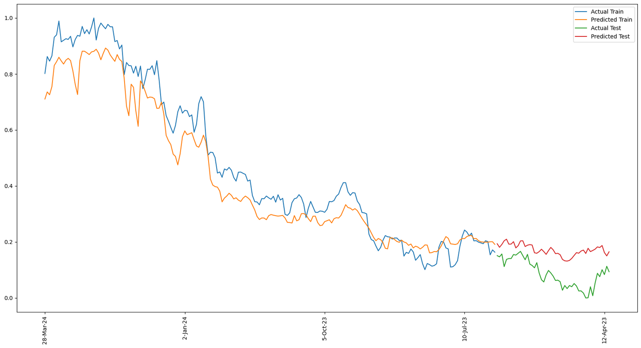
RESULTS
CLASSICAL LSTM

Slide 18
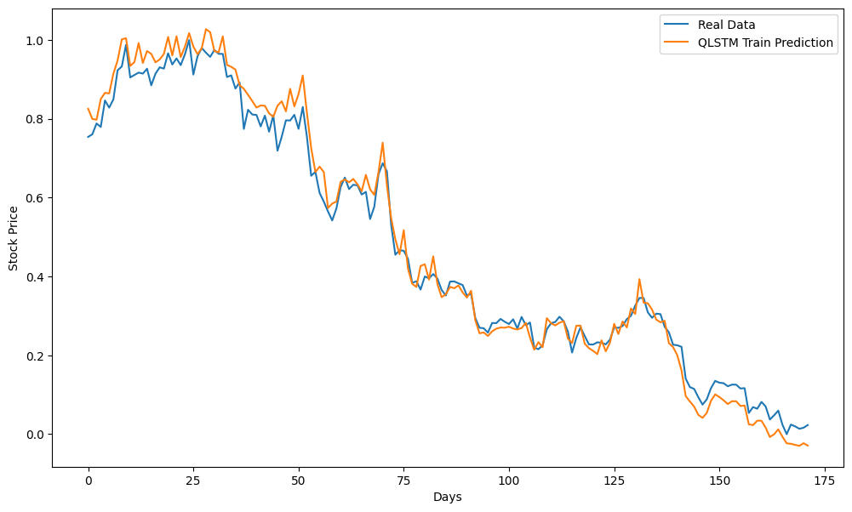
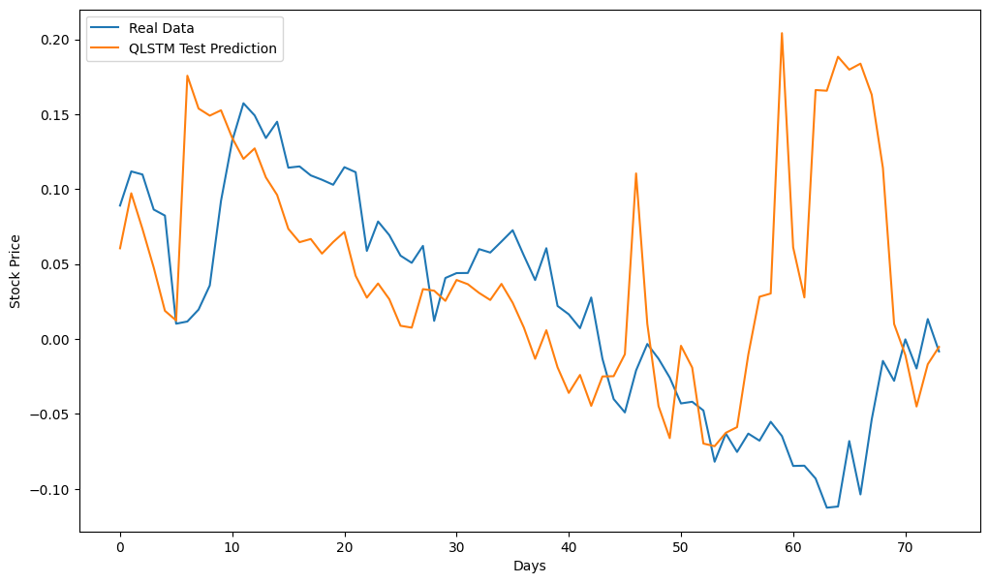
RESULTS
QUANTUM LSTM

Slide 19
FINDINGS
THE KEY FINDINGS FROM THIS STUDY ARE AS FOLLOWS: THE LSTM MODEL CONSISTENTLY MAINTAINED HIGH ACCURACY AND RELATIVELY LOW RMSE VALUES ACROSS BOTH TRAINING AND TESTING PHASES, SUGGESTING ROBUST GENERALIZATION. WHILE THE QLSTM MODEL ACHIEVED AN IMPRESSIVELY LOW TRAINING RMSE, THE SIGNIFICANT DROP IN TESTING ACCURACY INDICATES POTENTIAL OVERFITTING, WHICH COULD STEM FROM ITS COMPLEX ARCHITECTURE OR SENSITIVITY TO THE TRAINING DATA. INCORPORATING SENTIMENT-BASED FEATURES EXTRACTED FROM NEWS ARTICLES APPEARS TO ENHANCE THE PREDICTIVE PERFORMANCE, AS EVIDENCED BY THE OVERALL RESULTS.

Slide 20
INTERPRETATION
THE RESULTS SUGGEST THAT WHILE BOTH MODELS ARE CAPABLE OF LEARNING FROM THE INTEGRATED DATASET, THE LSTM MODEL OFFERS A MORE BALANCED PERFORMANCE. THE NEAR-UNIFORM ACCURACIES ACROSS TRAINING AND TESTING PHASES IMPLY THAT THE LSTM EFFECTIVELY CAPTURES THE UNDERLYING TEMPORAL AND SENTIMENT-BASED PATTERNS WITHOUT OVERFITTING. IN CONTRAST, THE QLSTM'S EXCEPTIONALLY LOW TRAINING ERROR, COUPLED WITH A MARKED DROP IN TESTING ACCURACY, POINTS TO A POTENTIAL OVER-PARAMETERIZATION OR EXCESSIVE SENSITIVITY TO THE TRAINING DATA, WARRANTING FURTHER REGULARIZATION OR HYPERPARAMETER TUNING.

Slide 21
DISCUSSION
THE STUDY UNDERSCORES THE POTENTIAL OF COMBINING TRADITIONAL STOCK MARKET INDICATORS WITH SENTIMENT FEATURES DERIVED FROM NEWS DATA. THE LSTM MODEL'S STABLE PERFORMANCE CONFIRMS THAT RECURRENT NEURAL NETWORKS CAN EFFECTIVELY INTEGRATE DIVERSE DATA TYPES FOR FINANCIAL FORECASTING. HOWEVER, THE QLSTM MODEL'S OVERFITTING ISSUES RAISE QUESTIONS ABOUT THE SUITABILITY OF MORE COMPLEX, QUANTUM-INSPIRED ARCHITECTURES IN SCENARIOS WITH LIMITED DATA VARIABILITY OR NOISE FROM SENTIMENT ANALYSIS. THESE FINDINGS HIGHLIGHT THE NEED FOR A CAREFUL BALANCE BETWEEN MODEL COMPLEXITY AND GENERALIZATION CAPABILITY. FURTHER EXPERIMENTATION WITH REGULARIZATION TECHNIQUES AND CROSS-VALIDATION STRATEGIES MAY HELP BRIDGE THE GAP OBSERVED IN THE QLSTM'S PERFORMANCE.

Slide 22
WHAT IS TO BE DONE NEXT
FUTURE WORK WILL FOCUS ON ENRICHING THE FEATURE SET TO IMPROVE PREDICTIVE PERFORMANCE FURTHER. IN PARTICULAR, WE ARE CURRENTLY INTEGRATING TO EXTRACT ADDITIONAL FEATURES FROM QUARTERLY BALANCE SHEETS. THESE FINANCIAL FUNDAMENTALS WILL COMPLEMENT THE EXISTING SENTIMENT AND MARKET DATA, OFFERING A MORE COMPREHENSIVE VIEW OF THE FACTORS INFLUENCING STOCK PRICE MOVEMENTS. THIS INTEGRATION IS EXPECTED TO PROVIDE DEEPER INSIGHTS AND POTENTIALLY ENHANCE THE MODEL'S ABILITY TO FORECAST MARKET TRENDS MORE ACCURATELY.

Slide 23
GUIDE APPROVAL MAIL SNAPSHOT

Slide 24

RESEARCH PAPER STATUS
Draft completed

Slide 25

REFERENCES
  Gu, Wenjun & Zhong, Shizun & Wei, Changsong & Dong, Liting & Wang, Zhuoyue & Yan, Chao. (2024). Predicting Stock Prices with FinBERT-LSTM: Integrating News Sentiment Analysis.
  S. Y. -C. Chen, S. Yoo and Y. -L. L. Fang, "Quantum Long Short-Term Memory," ICASSP 2022 - 2022 IEEE International Conference on Acoustics, Speech and Signal Processing (ICASSP)
  G. Jariwala, H. Agarwal and V. Jadhav, "Sentimental Analysis of News Headlines for Stock Market," 2020 IEEE International Conference for Innovation in Technology (INOCON)
  S. Mohan, S. Mullapudi, S. Sammeta, P. Vijayvergia and D. C. Anastasiu, "Stock Price Prediction Using News Sentiment Analysis," 2019 IEEE Fifth International Conference on Big Data Computing Service and Applications (BigDataService), Newark, CA, USA, 2019
  Xiaodong Li, Haoran Xie, Li Chen, Jianping Wang, Xiaotie Deng, News impact on stock price return via sentiment analysis, Knowledge-Based Systems, Volume 69, 2014, Pages 14-23, ISSN
  A More General Quantum Credit Risk Analysis Framework Authors: Emanuele Dri, Antonello Aita, Edoardo Giusto, Davide Ricossa, Davide Corbelletto, Bartolomeo Montrucchio and Roberto Ugoccioni Year: 2023 Journal: Entropy
  Variational quantum algorithms,M. Cerezo, Andrew Arrasmith, Ryan Babbush, Simon C. Benjamin, Suguru Endo, Keisuke Fujii, Jarrod R. McClean, Kosuke Mitarai, Xiao Yuan, Lukasz Cincio, Patrick J. Coles, Nature Reviews Physics, 2021
  Variational Quantum Circuits for Deep Reinforcement Learning,IEEE Access,2020,Samuel Yen-Chi Chen, Chao-Han Huck Yang, Jun Qi, Pin-Yu Chen, Xiaoli Ma1, Hsi-Sheng Goan
  Quantum computing for finance, Dylan Herman, Cody Googin, Xiaoyuan Liu, Yue Sun, Alexey Galda, Ilya Safro, Marco Pistoia, and Yuri Alexeev, Nature Reviews Physics, 2023
  The Predictive Ability of Quarterly Financial Statements,Hui Zhou, Worapree Ole Maneesoonthorn, Xiangjin Bruce Chen, International Journal of Financial Studies 2021

Slide 26
REFERENCES
11.Stock Market Trends Prediction after Earning Release Ran An , Chen Qian - , Wenjie Zheng
12.Machine learning techniques and data for stock market forecasting: A literature review
Mahinda Mailagaha Kumbure a, Christoph Lohrmann a, Pasi Luukka a, Jari Porras b
13.Forecasting Stock Market Prices Using Machine Learning and Deep Learning Models Gaurang Sonkavde Deepak Sudhakar Dharrao ,Anupkumar M. Bongale 1, Sarika T. Deokate
14.Bankruptcy Prediction Using Quarterly Financial Statement Data JANE BALDWIN,G. WILLIAM GLEZEN
15.Predicting the Effects of News Sentiments on the Stock Market Dev Shah, Haruna Isah, Farhana Zulkernine

Slide 27
THANK YOU

